Slide 1









Hypertension Detection
Feature Extraction and Selection for XBG Model
Victor Hug
16.09.2025

Slide 2
Methodology
Feature Selection 200+ Feature Options: see feature_comp.py / optimization.ipynb
Representation
Examples
Spectral & Waveform
Most features return other arrays („signals“), for which different properties can be used as input features for the model.
Default property selection:
mean
std
min
max
kurtosis
skewness
median
var
sum
variance coefficient
Blood Pressure (ABP):
Systolic Peaks, Diastolic Peaks, Distal Peaks
Pulse Pressure
Systolic–Diastolic Time Difference
Pulse Transit Time (with PPG)
Heart Rate (ABP-derived)
Electrocardiogram (ECG):
Heart Rate (ECG-derived)
Low-Frequency Power, High-Frequency Power, LF/HF Ratio
LF/HF Ratio
Photoplethysmogram (PPG):
Harmonic Ratio (H2/H1)
Raw Signals
ECG (lead II, V)
ABP
PPG
No Capnogram used, due to lack of usage in other studies [1] [2]
Spectral Information:
Wavelet Entropies (all)
Spectral Centroid (all)
Filter: Band-Pass was used for some signals. With both filtered and unfiltered signals used

Slide 3
Methodology
Feature Selection Optimization see optimization.ipynb
Genetic Feature Selection
Possibilities & Limitations
Evolutionary Optimization for Feature Selection (by sklearn_genetic) Tested with different properties:
max features
goal metric
estimators
max depth
StandardScaler Pipeline was integrated into optimization at a later stage.
Outlier Removal as well, however this could not be used in the main training pipeline, due to fixed main.py
Possibilities:
Handles 200+ Features and Millions of Combinations
Directly optimizing for different metrics
Limitations:
Performance depends on configuration (genetic parameter, max_features etc.)
May not fully represent the pipeline in model.py, so not directly optimizing for that
Optimizer usually returns feature sets that are almost as big as the configured max_features

Slide 4
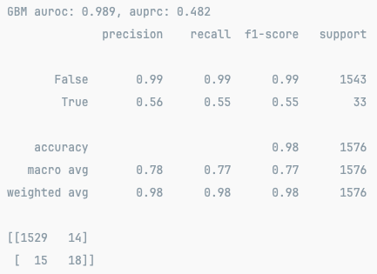
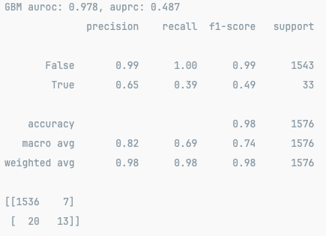
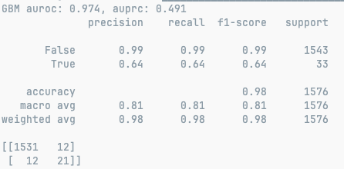
Results (to change the version, replace “selected_features_select” in feature_comp.py)
These Features were often represented in the selections (Geneticly Optimized):
ABP Peaks (Syst, Dist), Pulse Transit Time (PTT), Wavelet Entropies, Pulse Pressure, Dist-Syst Time-Difference
Best Values: AUPRC: 0.491 (0.585*) AUROC: 0.989
*after filtering for faulty data (about one dozen samples)
Runs made by main.py (no modifications): change feature selection version in feature_comp.py:514
V1: 73 Features Tuned for Precision Max 75 Features
v3: 19 Features Tuned for AUROC
Max 30 Features
V5: 37 Features Tuned for AUPRC
Somehow did not go for the .8 AUPRC with
0 TP in Confusion Matrix

Slide 5
Discussion
Evaluation Metrics
Faulty Data can not be filtered
Fixed Model
Future Research
AUROC:
Value is always very high, but this is only due to imbalance
AUPRC:
Highest achieved was 0.8, but the model does not return True Positives, only Negatives in the Confusion Matrix
Due to it being calculated in the probability space, the auprc in some trials was high (>0.8), while the model never returns a probability >= 0.5
No possibility to remove faulty data (like interrupted ABP)
Using the filtered dataset for training results in increased True positives (up to 27 TP) and higher AUPRC (+0.1)
You can see and test the removal of faulty data in „quick_start.py“ (line 29-35)
The data is highly imbalanced, and while Gradient Boosting mitigates this slightly, the forming of a generalized decision boundary is difficult
The model / pipeline restricts the performance
State of the art studies use more sophisticated models to evaluate bio-signals like [3]
The importance of feature extraction and selection can be minimized by using a models that can extract data themselves from raw signal or general waveform transformations (Like CNNs or LSTMs)
Other Models
Data Augmentation to fight imbalance in the dataset
Data Inspection and cleansing, retrieving additional data
Additional Visualizations, like extension of confusion matrix by showing different probability spaces
Robust filters for accurate features (like Kalman for HR)

Slide 6
Sources
[1] Automated detection of severity of hypertension ECG signals using an optimal bi-orthogonal wavelet filter bank https://pubmed.ncbi.nlm.nih.gov/32768053/
[2] Systolic blood pressure estimation using ECG and PPG in patients undergoing surgery https://www.sciencedirect.com/science/article/pii/S1746809422005171
[3] Enhancing ECG classification with continuous wavelet transform and multi-branch transformer https://pubmed.ncbi.nlm.nih.gov/38434292/

